Slide 1

BLOOD BANK MANAGEMENT SYSTEM
Give Blood Save Life.

Slide 2

BANGLADESH UNIVERSITY OF BUSINESS & TECHNOLOGY (BUBT)
Participants Are: Dept. Of CSE
Name of Students | ID | Intake
Md Imran Hossen | 21222203001 | 41-01
Rajesh Chandra Barman | 21222203002 | 41-01
Jakir Hossain | 21222203003 | 41-01
Istiak Ahmed Arnob | 21222203028 | 41-01
Bikash Chandra Ray | 21222203045 | 41-01
Rohan Rashid | 21222203050 | 41-01

Slide 3

Supervisor
Under Supervision of:
Sondip Poul Singh
Lecturer,
Department of Computer Science & Engineering,
Bangladesh University of Business & Technology.

Slide 4
Requirements
PC Configuration: Core i7 4th Gen With 16GB Ram.
OS-: Linux Ubuntu 24.05.
Software: NetBeans IDE,Apache Xampp & Firefox
Browser.
Code Editor: Net Beans IDE
Programming Language: Java.
Maximum Time: 5 weeks.

Slide 5
Table of contents
01
02
03
04
05
06
Introduction
Background
System Architecture
XAMPP,NetBeans Setup
User Interfaces
Goals & Conclusion

Slide 6

Introduction to the Project
The Blood Bank Management System automates donor and recipient processes, optimizes blood inventory management, and streamlines donation and distribution. Utilizing XAMPP for a local server for efficient blood bank operations. This report outlines the design of the system to enhance healthcare services.

Slide 7
Blood banks face challenges such as high demand for products, inefficient manual processes in donor and inventory management, and a lack of centralized systems. These issues hinder the timely and effective supply of blood products. Addressing these challenges requires adopting modern technologies for automated donor management, inventory tracking, and implementing centralized systems for streamlined operations. Challenges in Blood Banks: i. High demand for blood products. ii. Inefficient manual processes in donor and inventory management. iii. Lack of a centralized system for streamlined operations.
Background

Slide 8
System Architecture
Admin Panel
The Admin Panel is a secure and privileged interface of the Blood Bank Management System, accessible only to authorized administrators. It allows administrators to manage user accounts, donor information, blood inventory, transactions, and generate reports for effective oversight and control of the blood bank operations.
User Panel
The User Panel is an interface designed for general users, such as blood donors, medical facilities, and other stakeholders involved in the blood donation process.

Slide 9
Admin Panel
Access Control: The admin panel is accessible only to authorized personnel such as administrators or blood bank staff.
User Management: Admins can manage user accounts, including creating new accounts, modifying user information, and deactivating or deleting accounts when necessary.
Donor Management: Admins can add new donors to the system, update donor information, and manage donor records. This includes details such as name, contact information, blood type, and donation history.
Inventory Management: Admins can manage the inventory of blood units available in the blood bank. This involves tracking the quantity of each blood type, expiration dates, and any other relevant information.
Transaction History: Admins can view and manage the history of blood transactions, including donations, withdrawals, and transfers. This helps in maintaining a transparent record of the blood bank's activities.
Reports and Analytics: The admin panel may include features for generating reports and analytics related to blood inventory, donations, and other relevant metrics. This can assist in making informed decisions and identifying trends.

Slide 10
User Panel
Blood Location: Donors can show available blood by Location.
View Donation History: Donors can view their own donation history, including the dates of their previous donations, the amount donated, and any relevant notes or feedback.
Search for Blood: Users, such as hospitals or medical facilities, can use the user panel to search for available blood units based on blood type and quantity required.
Request Blood: Facilities in need of blood can use the user panel to request specific blood types and quantities. This request is then processed by the blood bank administrator.
Profile Management: Users can manage their personal profiles, update contact information, and make any necessary changes to their accounts.

Slide 11

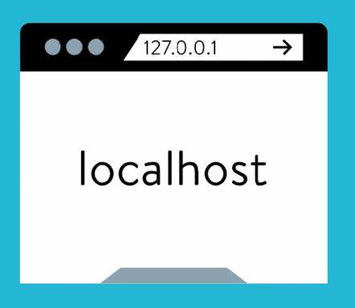
Xampp Setup
XAMPP is a free and open-source cross-platform web server that includes Apache, MySQL, PHP, and Perl . It is designed to make it easy for developers to create and test their programs on a local webserver . XAMPP is available for Windows, Linux, and OS.
Download Xampp.
Install it from Ubuntu Terminal.
After installation open it.
Start MySQL Server.
Opem Any Browser & go to localhost.

Slide 12

NetBeans IDE Setup
The Smarter and Faster Way to Code. NetBeans IDE is a free and open source integrated development environment for application development on Windows, Mac, Linux, and OS.
Download NetBeansIDE.
Install it from Ubuntu Terminal.
After installation open it.
Create a new Project.
Under the project Create package.
Also Create new Jframe From

Slide 13


Interfaces
Database Interface
A database is an organized collection of data, stored and accessed electronically. Databases are used to store and manage large amounts of structured and unstructured data, and they can be used to support a wide range of activities, including data storage, data analysis, and data management.
Application Interface
Application interface is the set of features an application provides so that a user may supply input to and receive output from the program..

Slide 14
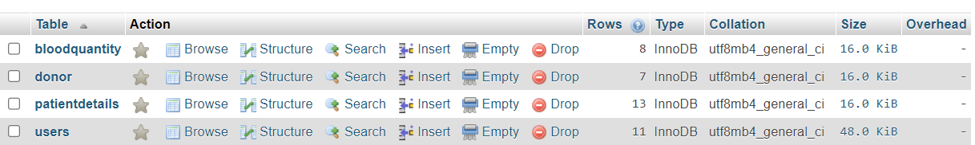
Database Interfaces
All Tables:
BloodQuantity
Donor
PatientDetails
Users

Slide 15
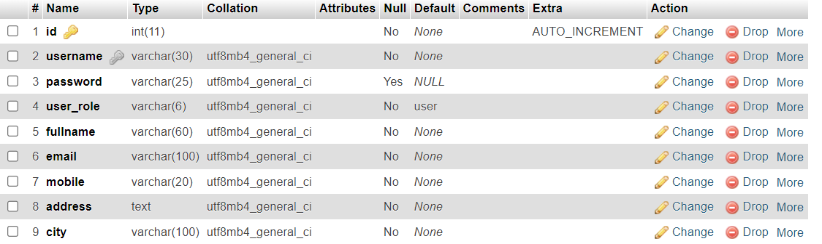
Database Interfaces
Single Table Stracture: PatientDetail

Slide 16
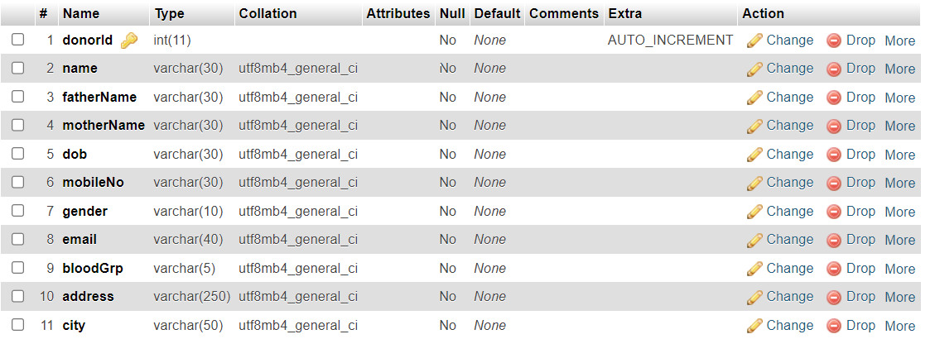
Database Interfaces
Table View from database: Donor

Slide 17

Application User Interfaces
There are some various Interfaces in Application.Such as:
Log in
Home
Details
Blood Stocks
Blood Search
Profile, Etc.

Slide 18
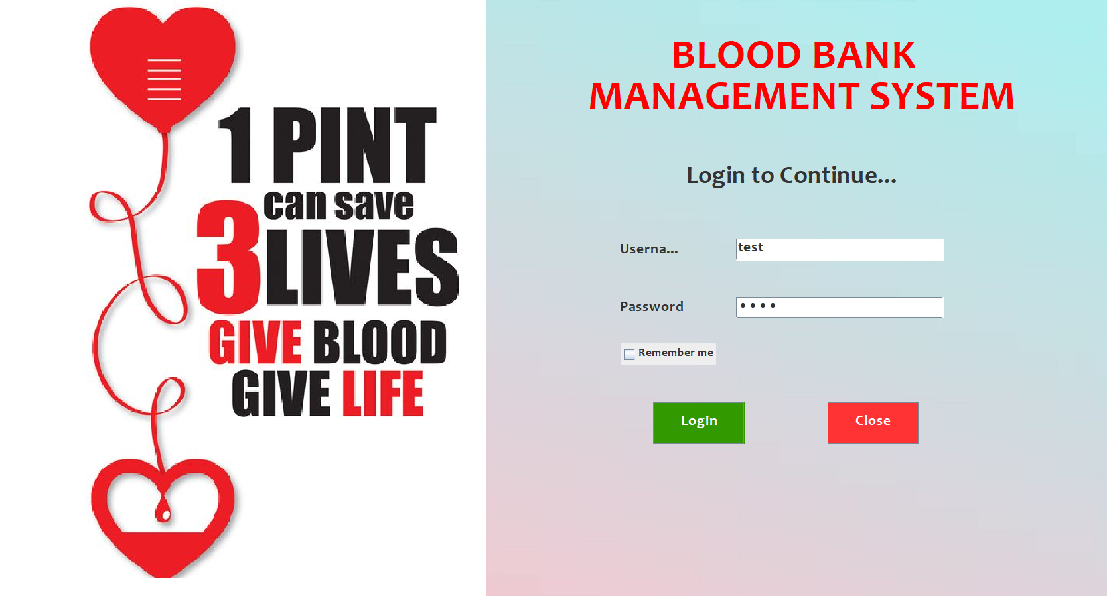
Application Interfaces
Log In Page:

Slide 19
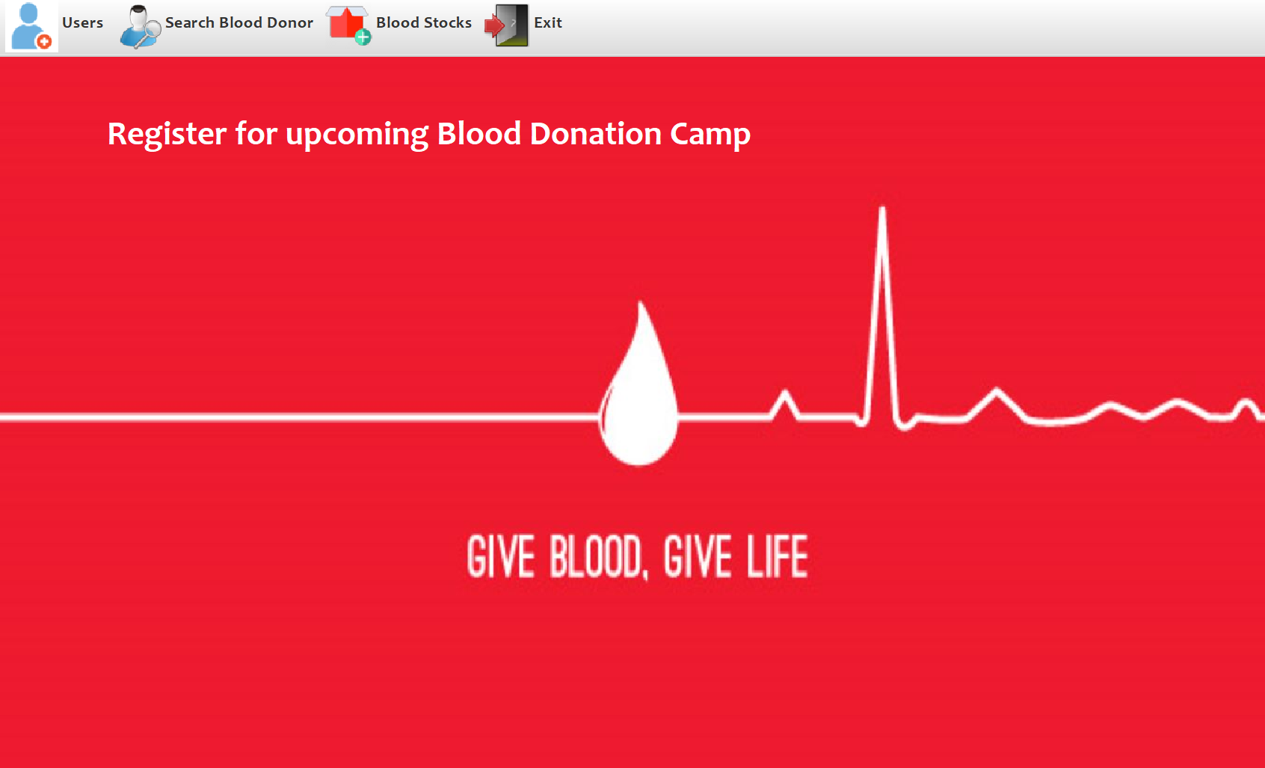
Application User Interfaces
User Home:

Slide 20
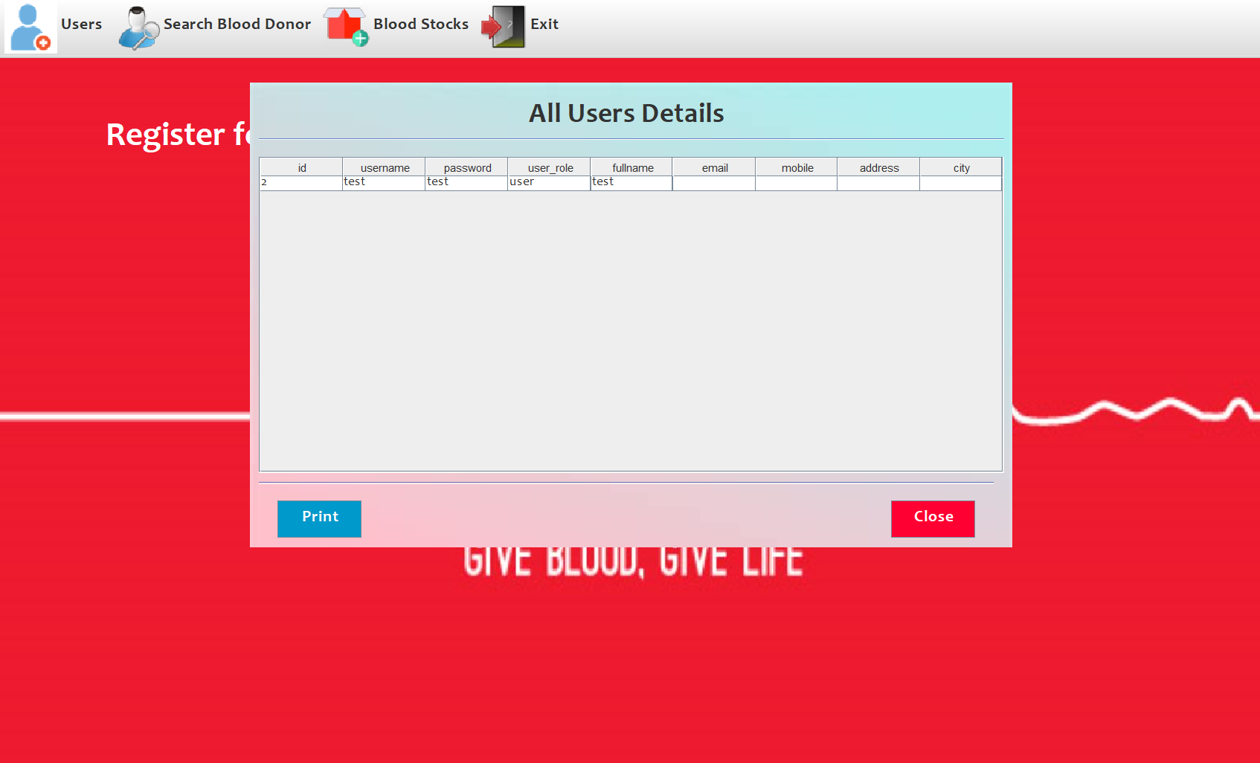
Application User Interfaces
User Profile

Slide 21
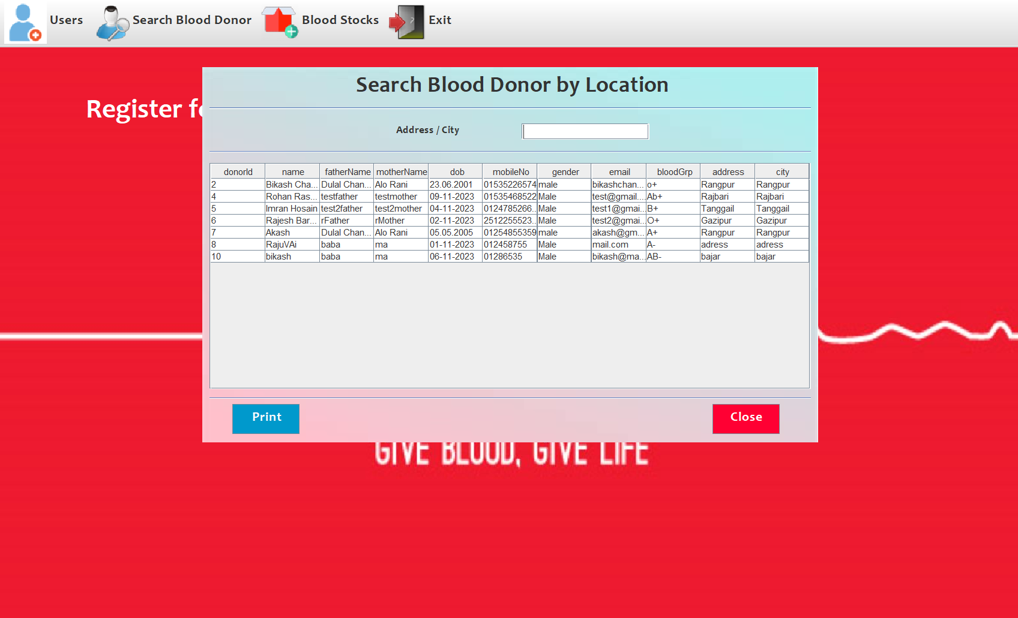
Application User Interfaces
Search Blood Donor From Location

Slide 22
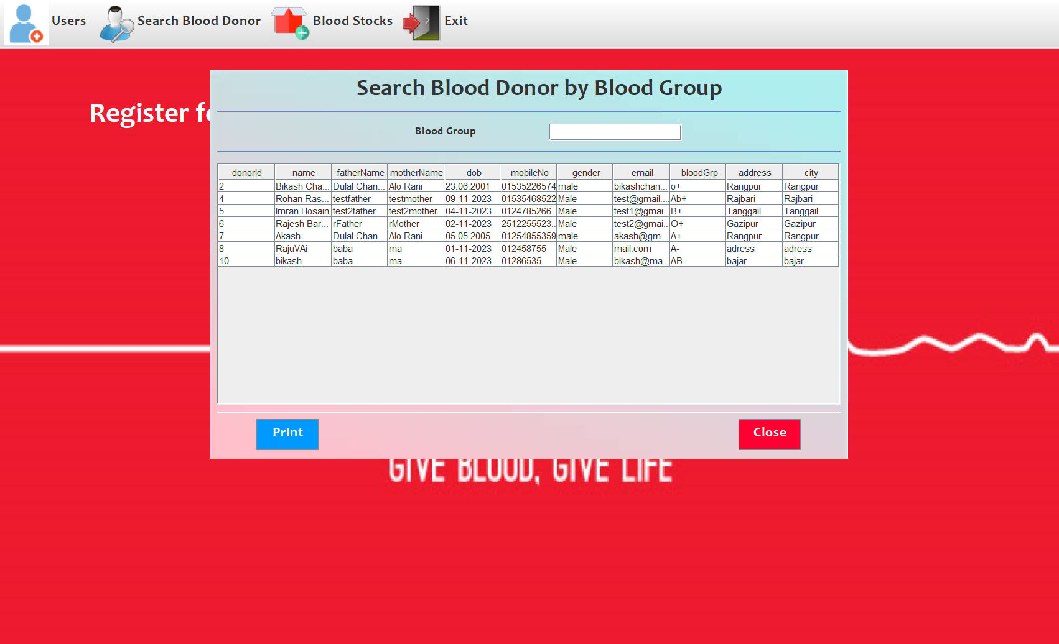
Application User Interfaces
Search Blood

Slide 23
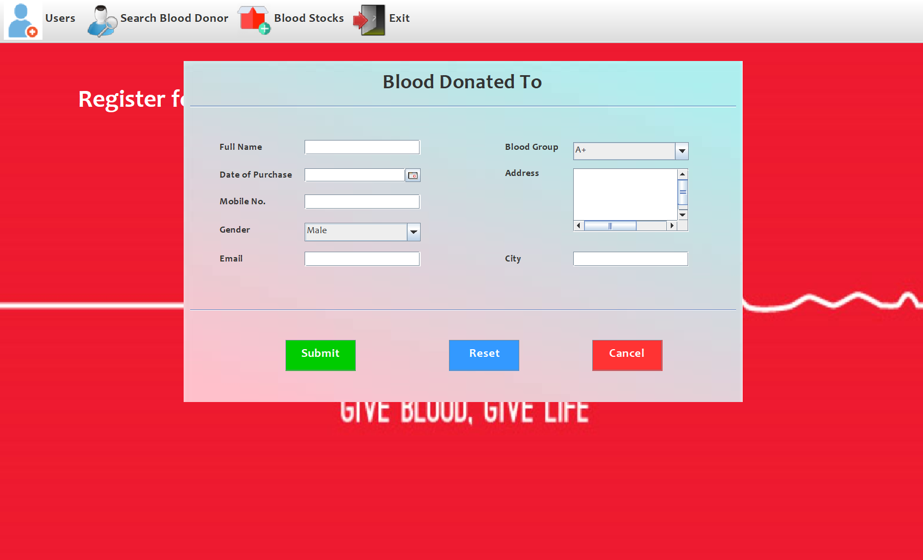
Application User Interfaces
Purchase Blood

Slide 24
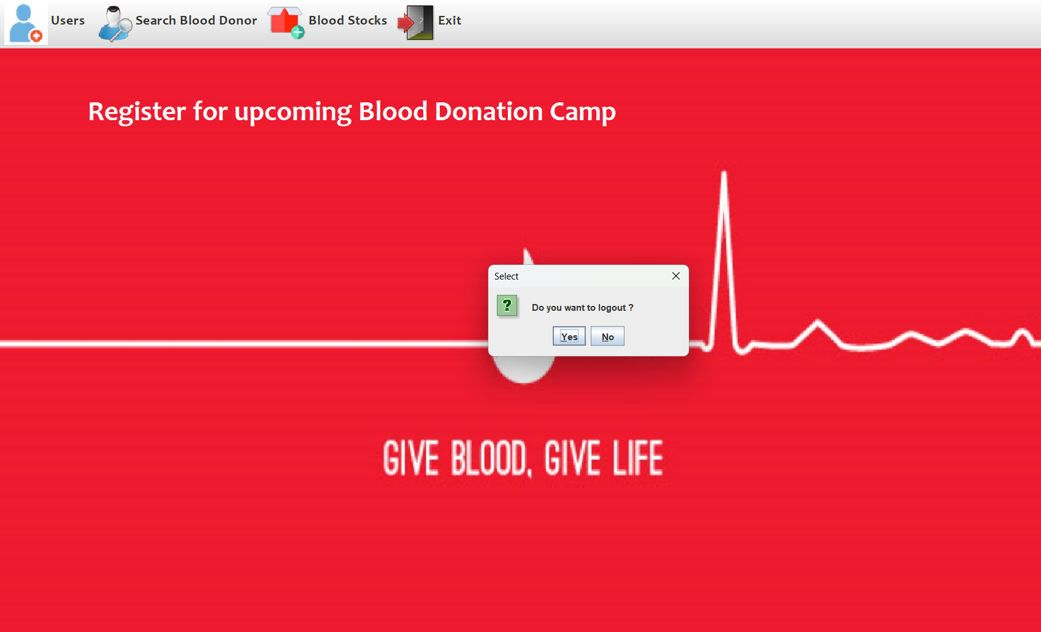
Application User Interfaces
Logout Menu

Slide 25
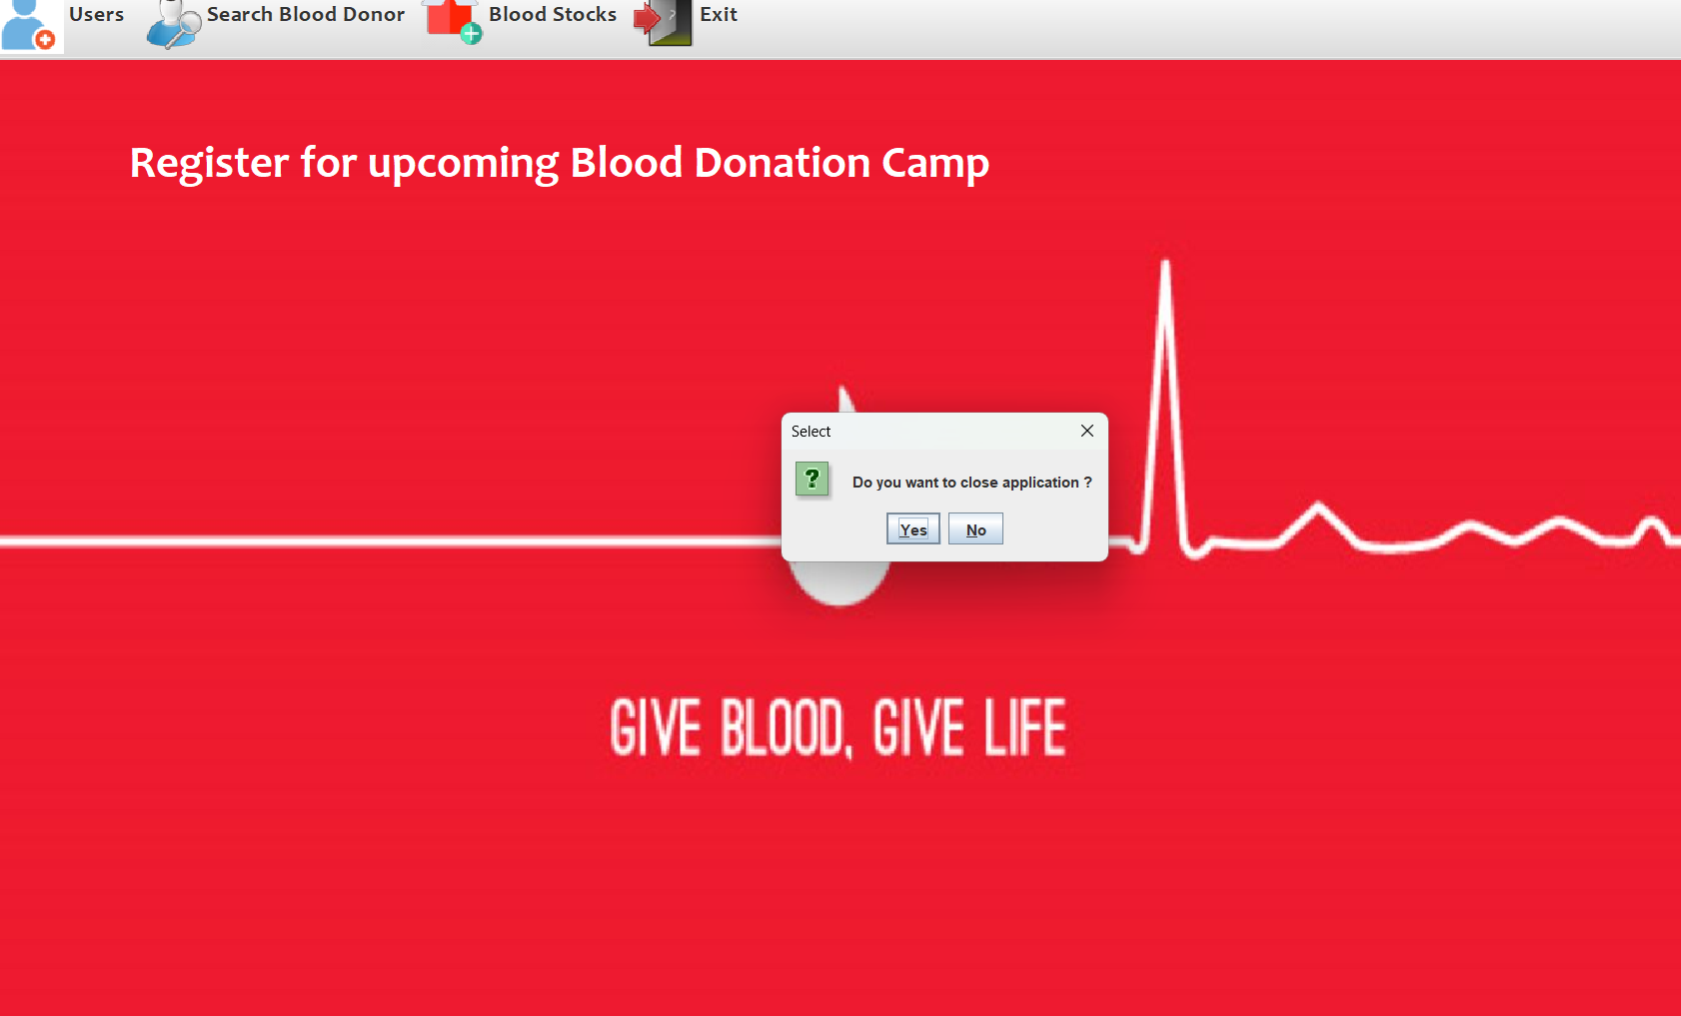
Application User Interfaces
Exit Application

Slide 26
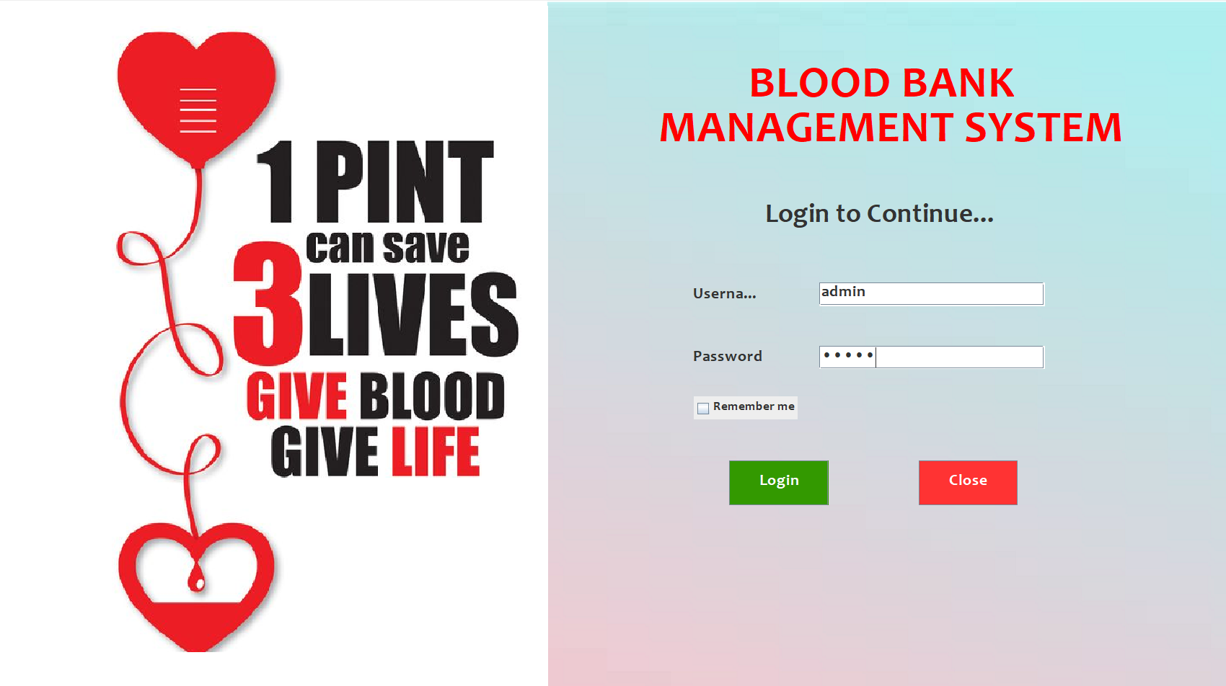
Application Admin Interfaces
Admin Login

Slide 27
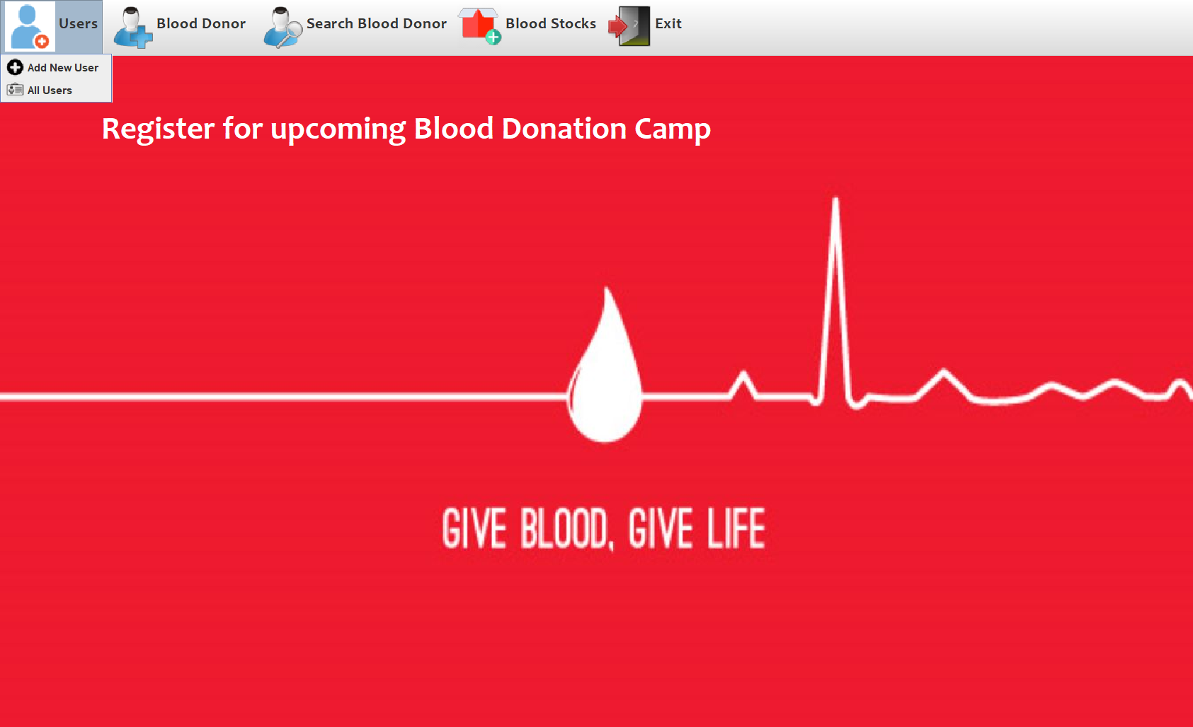
Application Admin Interfaces
Admin Access User Menu

Slide 28
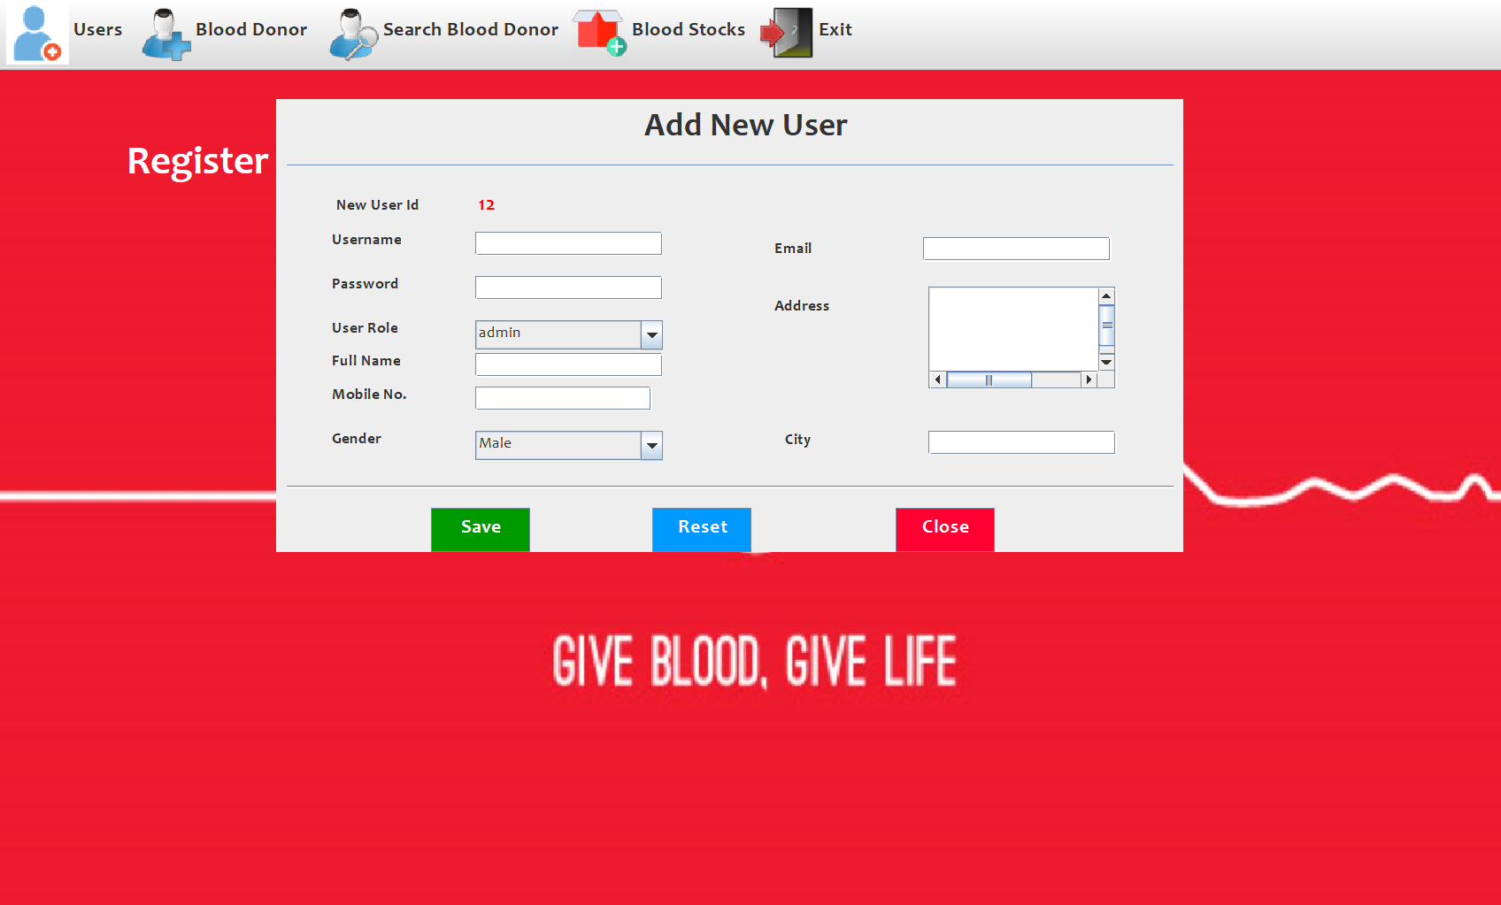
Application Admin Interfaces
Admin Add New User

Slide 29
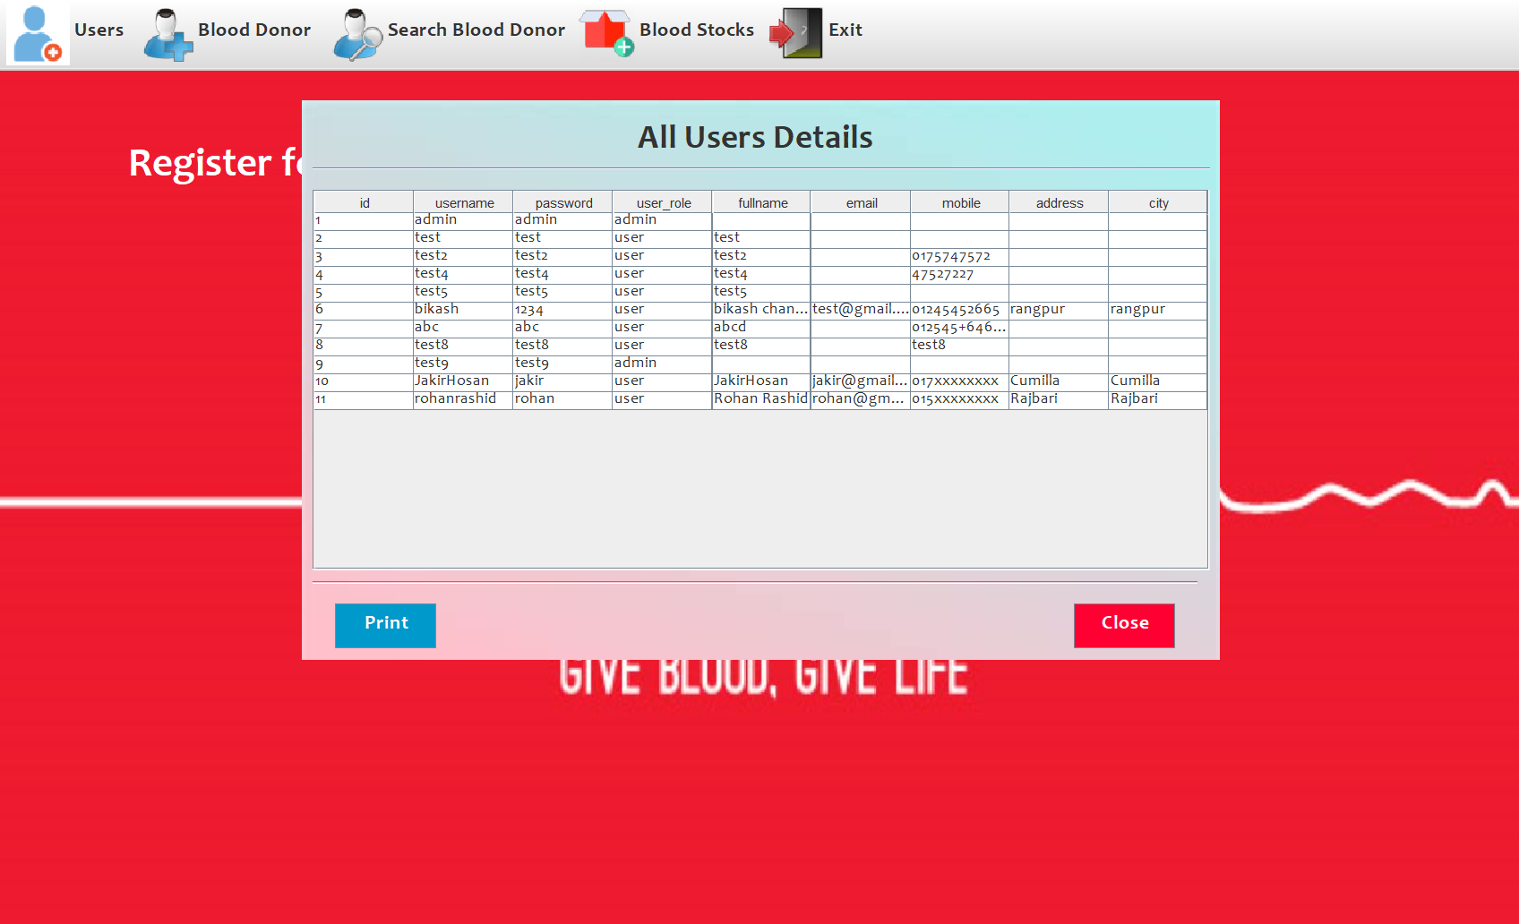
Application Admin Interfaces
Admin All User

Slide 30
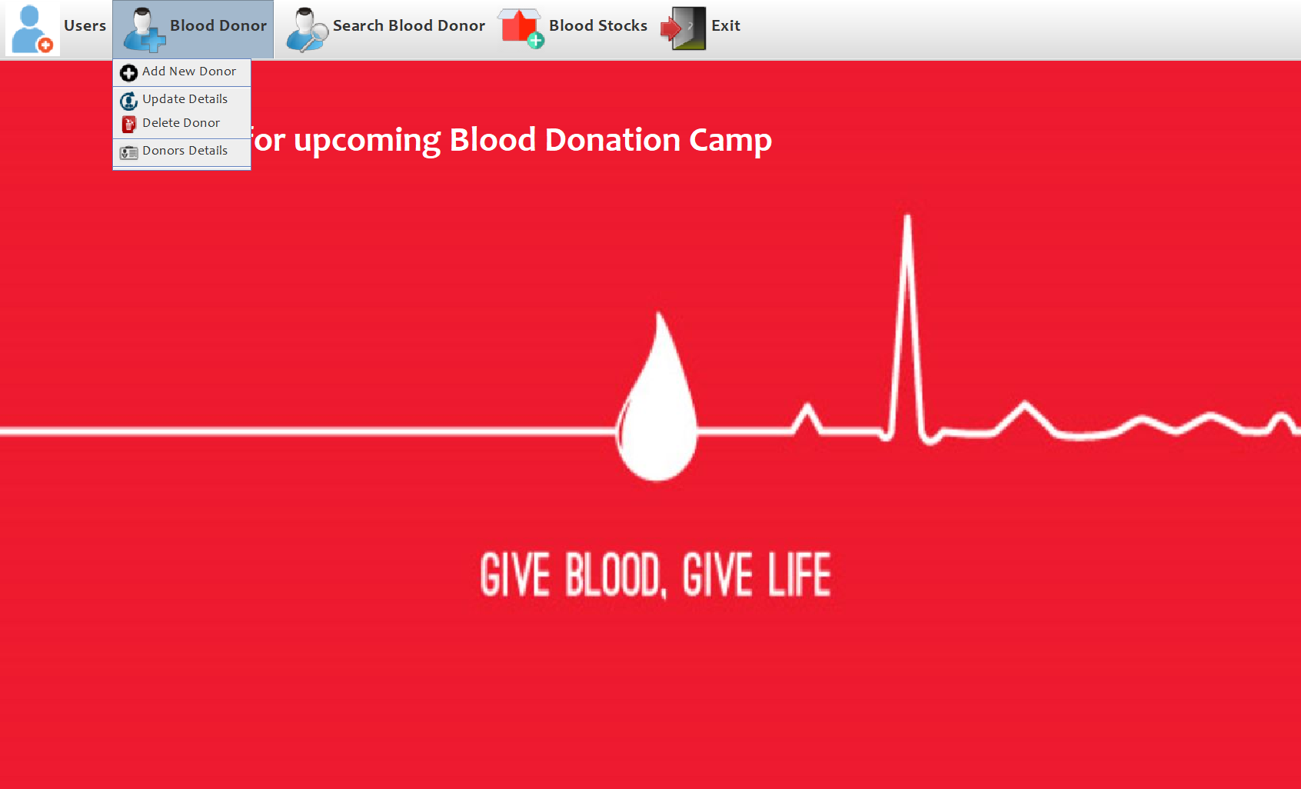
Application Admin Interfaces
Admin Login

Slide 31
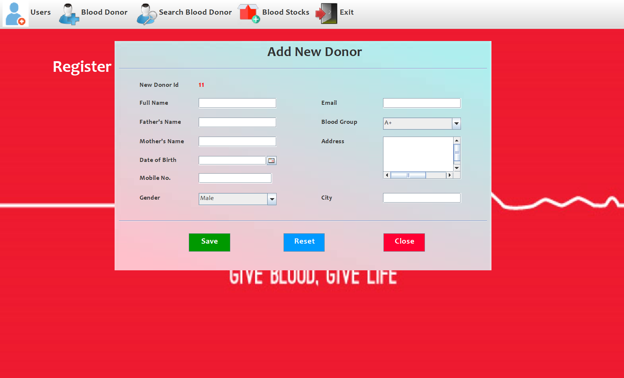
Application Admin Interfaces
Admin Add New Donor

Slide 32
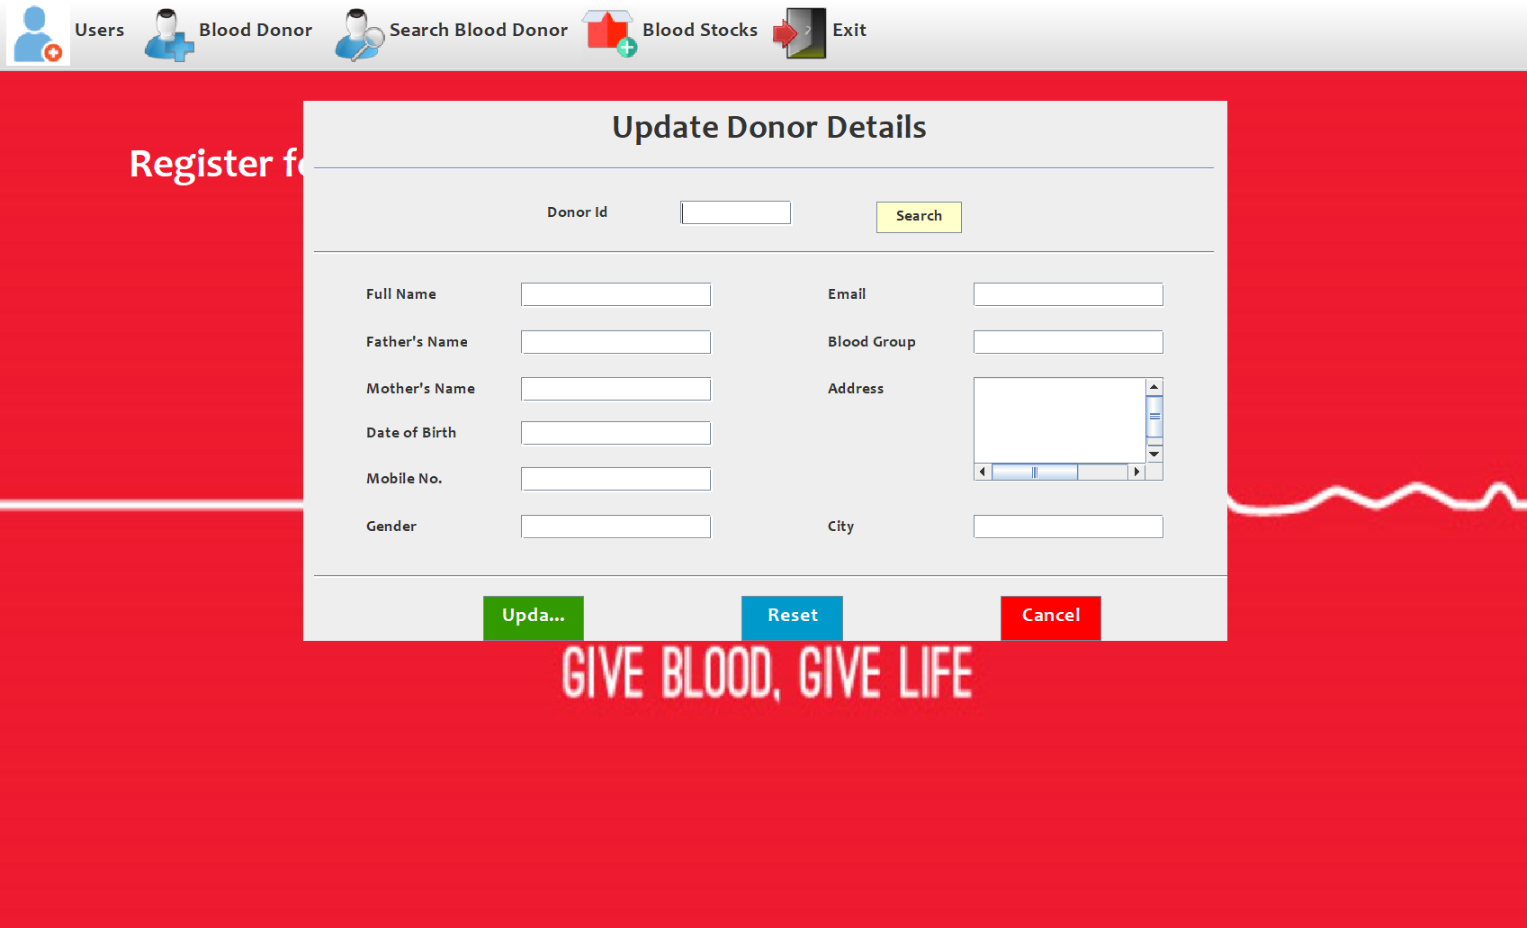
Application Admin Interfaces
Admin Update Donor Details

Slide 33
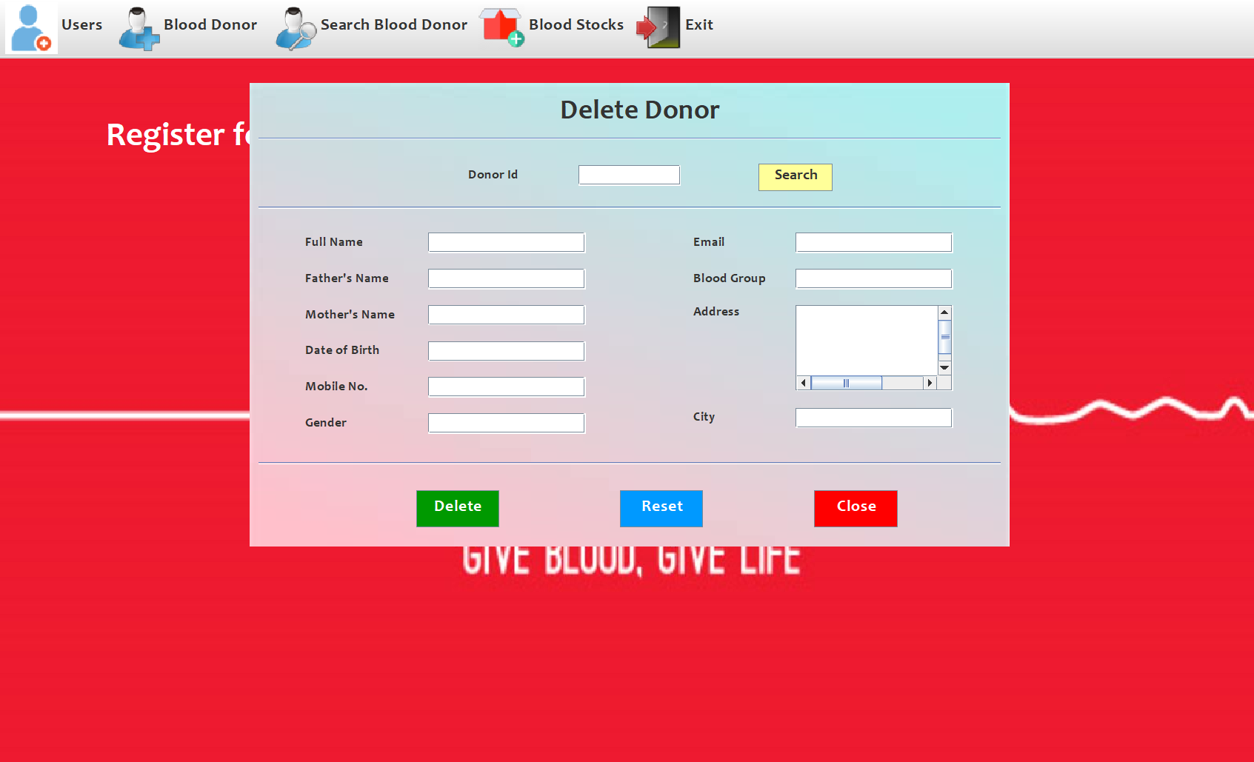
Application Admin Interfaces
Admin Delete Donor

Slide 34
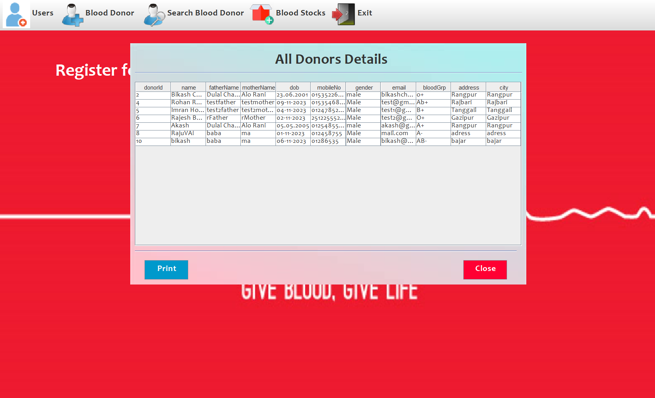
Application Admin Interfaces
Admin Access All Donor Details

Slide 35
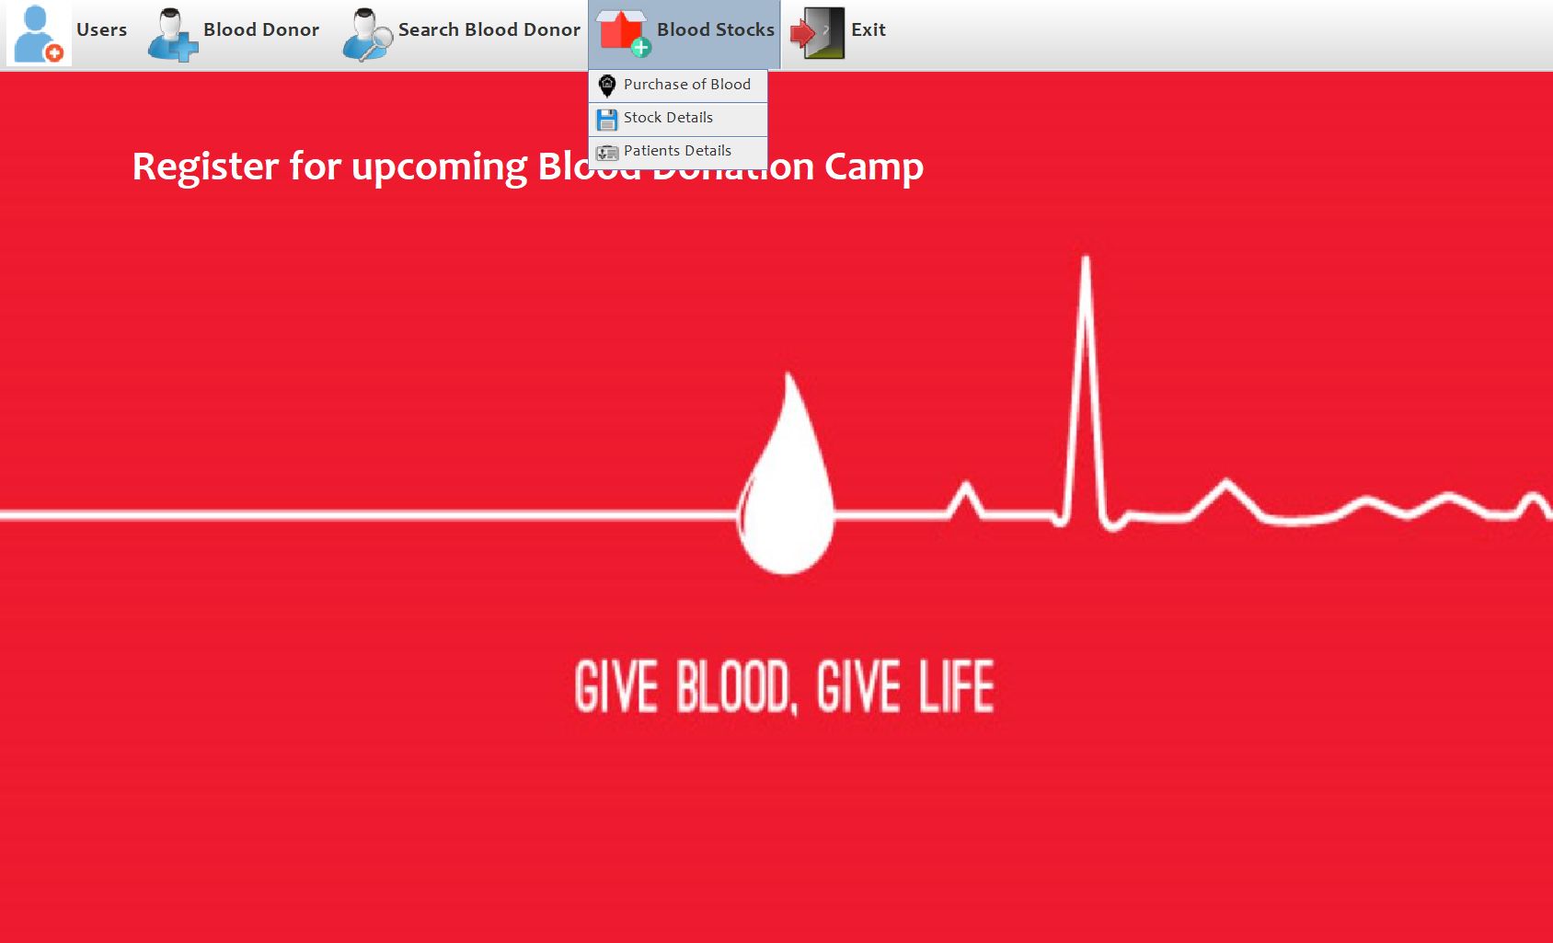
Application Admin Interfaces
Admin Access Blood Stocks Menu

Slide 36
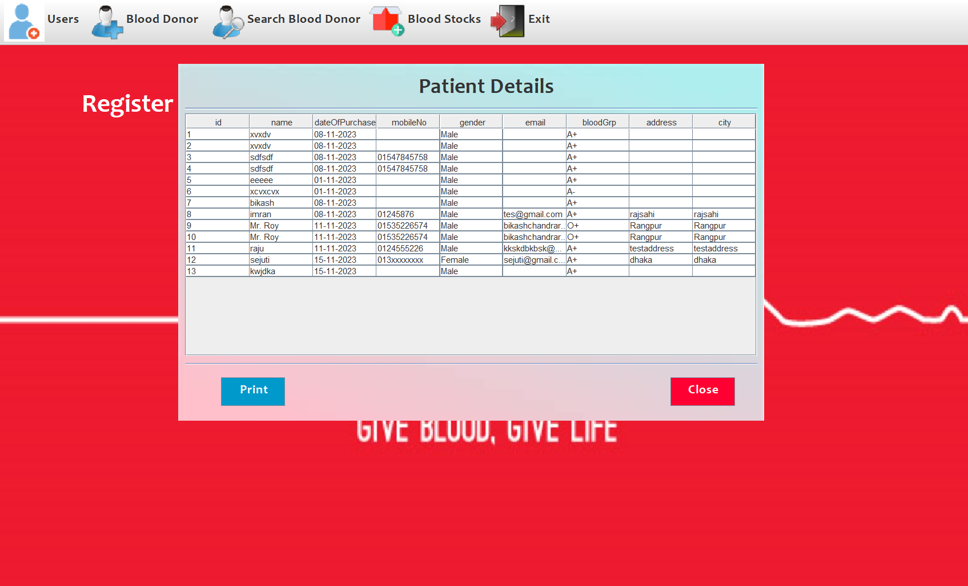
Application Admin Interfaces
Admin Access All Patients Details

Slide 37
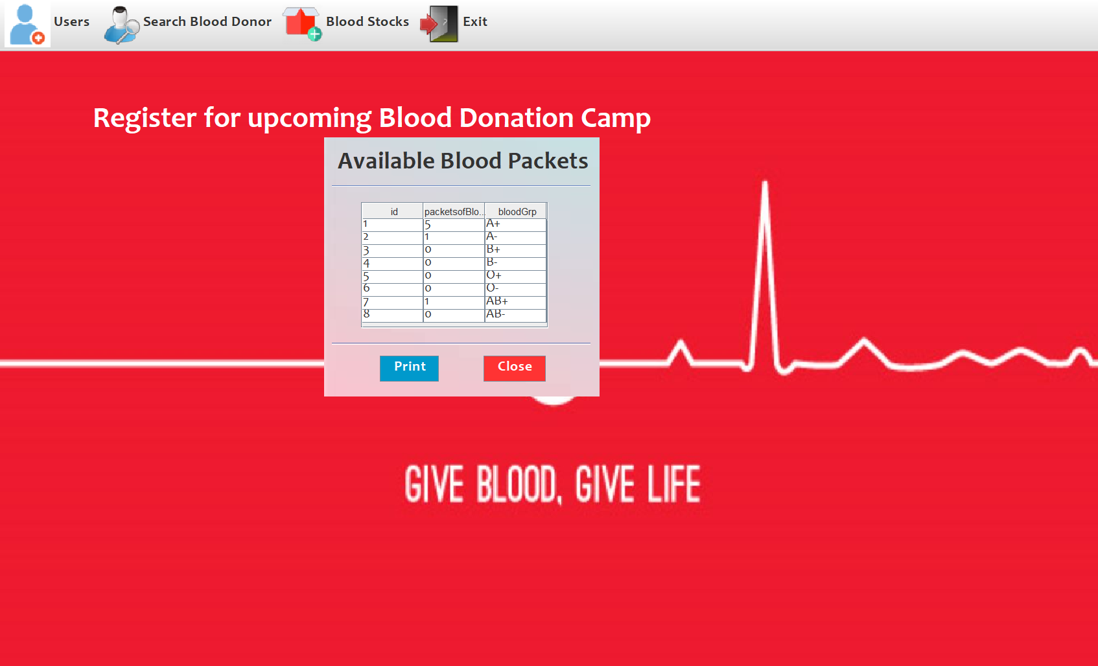
Application Admin Interfaces
Admin Access Available Blood Stocks

Slide 38
Goals of this Project
1. **Efficiency:** Automation eliminates manual paperwork, accelerating donor registration and blood distribution processes, reducing the likelihood of errors, and improving overall efficiency.
2. **Accuracy:** Real-time inventory tracking ensures precise availability information, minimizing the risk of shortages or excess, and optimizing blood bank resources.
3. **Accessibility:** Intuitive user interfaces facilitate easy navigation, promoting efficient use by blood bank staff with varying technical expertise, ensuring broader accessibility.
4. **Security:** Robust security measures, including encryption and access controls, protect sensitive donor and recipient data, ensuring compliance with data protection regulations.
5. **Cost-Effective:** Local server deployment with XAMPP eliminates the need for expensive external hosting, reducing operational costs for blood banks with limited resources.

Slide 39

Question?

Slide 40
Question: What potential future enhancements are considered for the system? Answer: Future enhancements may include scalability improvements, additional features such as analytics and automated reporting, and integration with external systems to further streamline blood bank operations and enhance overall functionality.
Question: What measures are in place to ensure the accuracy of the blood inventory? Answer: Real-time inventory tracking is implemented to provide accurate and up-to-date information on blood availability. This minimizes the risk of shortages or excess, allowing blood banks to optimize their inventory and respond effectively to varying demand.
QUESTIONS
Question: Can the system accommodate future growth in data volume? Answer: Yes, the system is designed with scalability in mind. It can easily accommodate increased data volumes by leveraging database optimization strategies and, if necessary, transitioning to cloud-based solutions for enhanced scalability.
Question: Why choose XAMPP for local server deployment? Answer: XAMPP provides a convenient and cost-effective solution for local server deployment. It includes Apache, MySQL, PHP, and phpMyAdmin, simplifying the setup process and reducing the reliance on external hosting services, making it an ideal choice for blood banks with limited resources.

Slide 41

Conclusion
In conclusion, the Blood Bank Management System stands as a successful endeavor, achieving its objectives, overcoming challenges, and positively impacting blood bank operations. The Blood Bank Management System has successfully met and exceeded its primary objectives, resulting in substantial achievements in the improvement of blood bank operations.This project not only modernizes processes but also contributes to the advancement of healthcare services related to blood transfusions, ultimately saving lives and improving the overall well-being of the community.

Slide 42

Thanks For Watching Our Presentation Carefully…

